Slide 1
PalatiMe Workflow & Screen Shots
Angadbir Salara
INFO 697

Slide 2
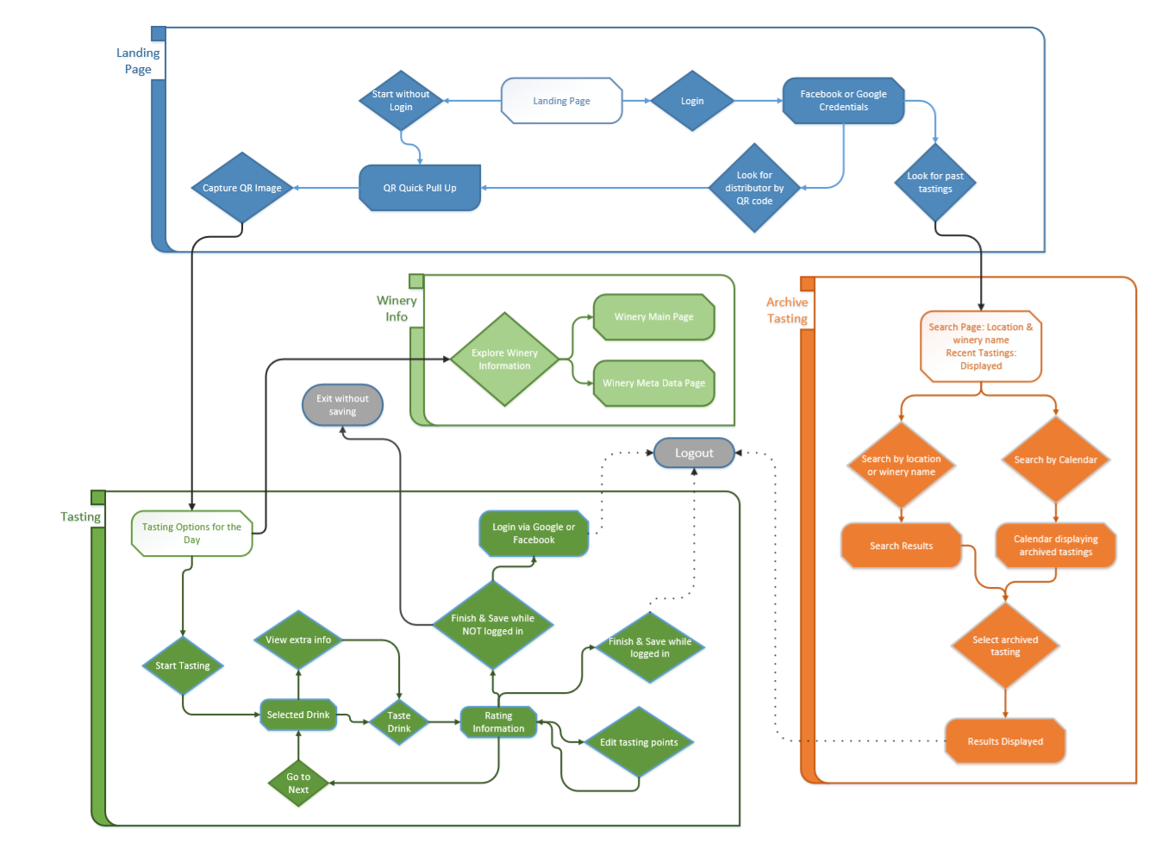
W
O
R
K
F
L
O
W

Slide 3
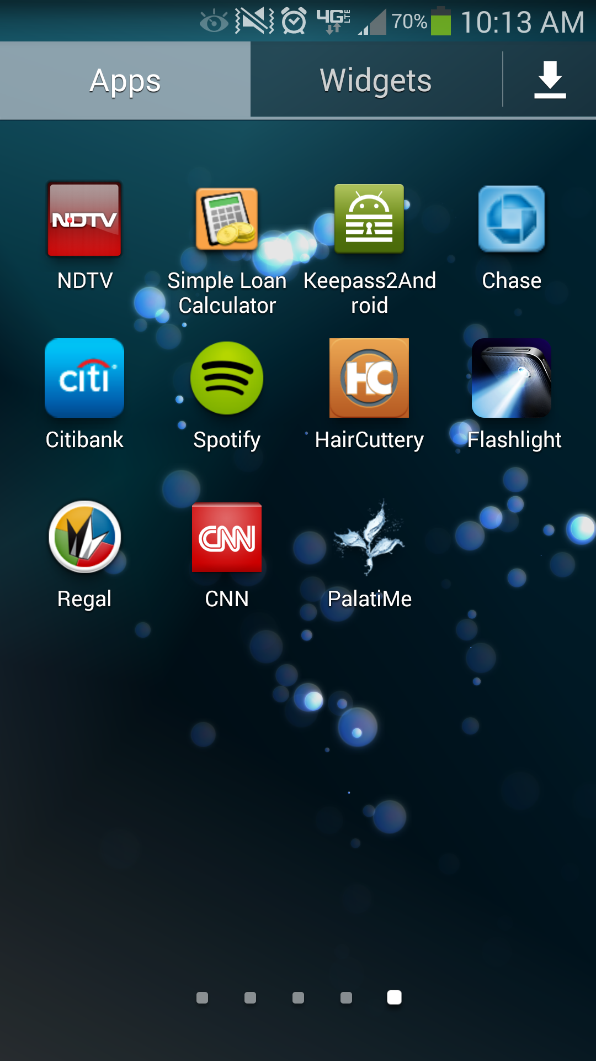
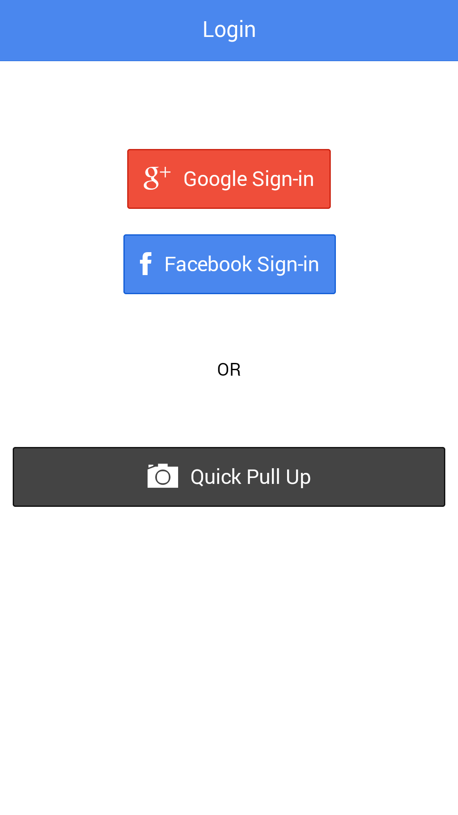
Opening App
for the first time.

Slide 4
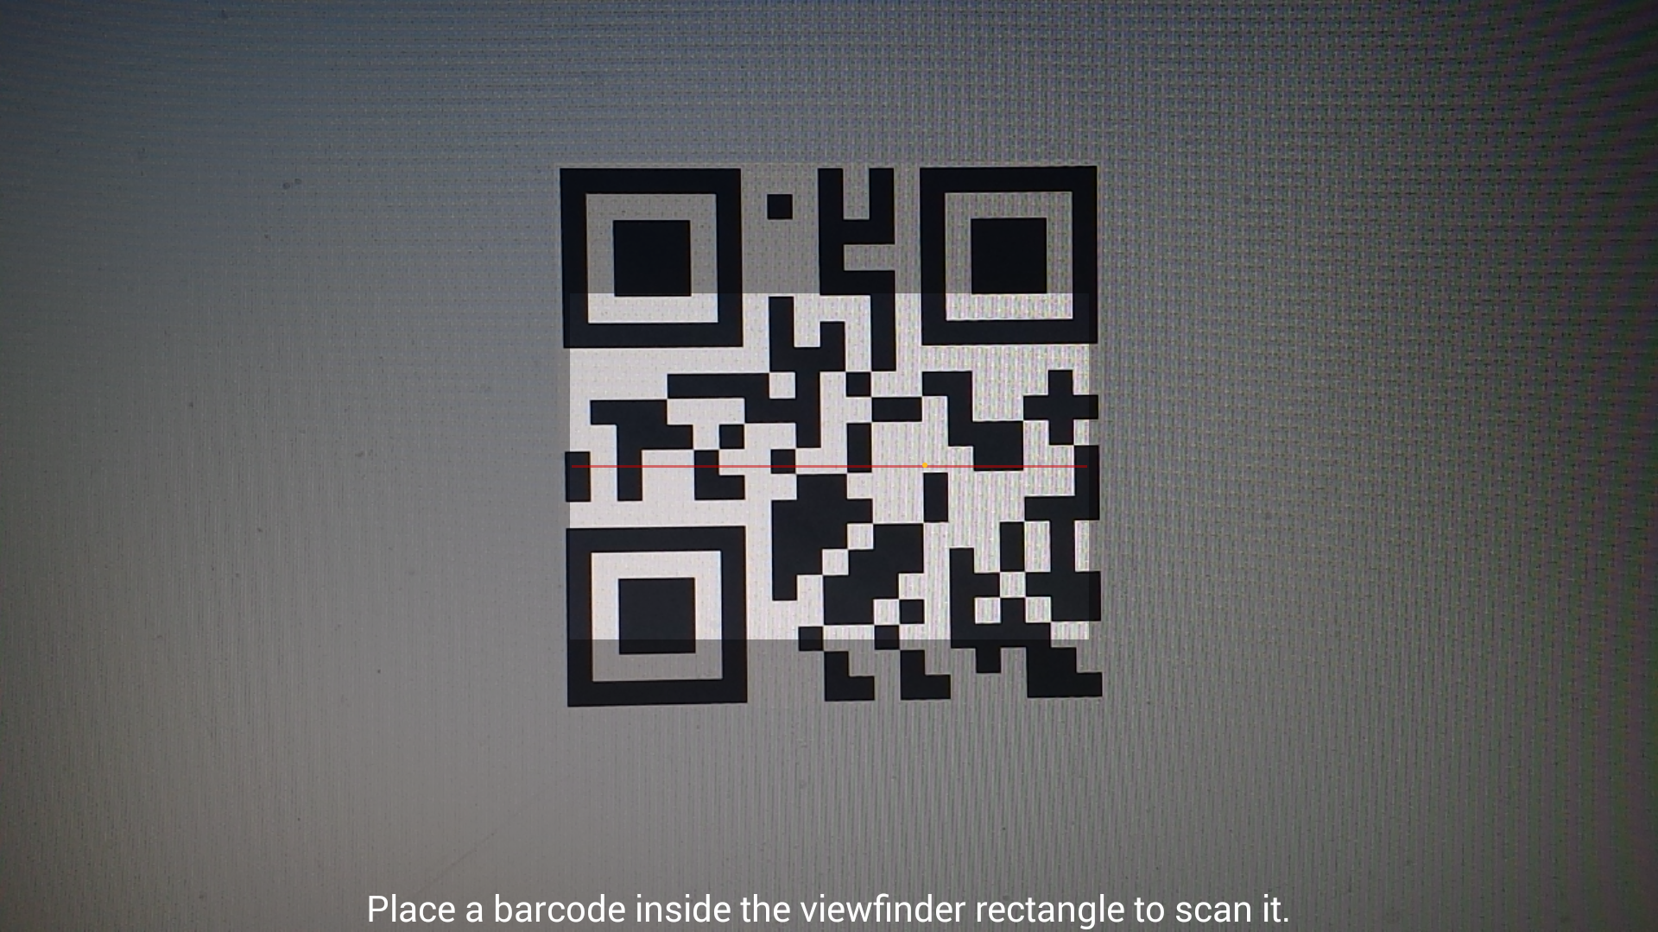
User need not sign in to start using the app.
“Quick Pull Up” opens the QR reader to scan a QR code of a winery.

Slide 5
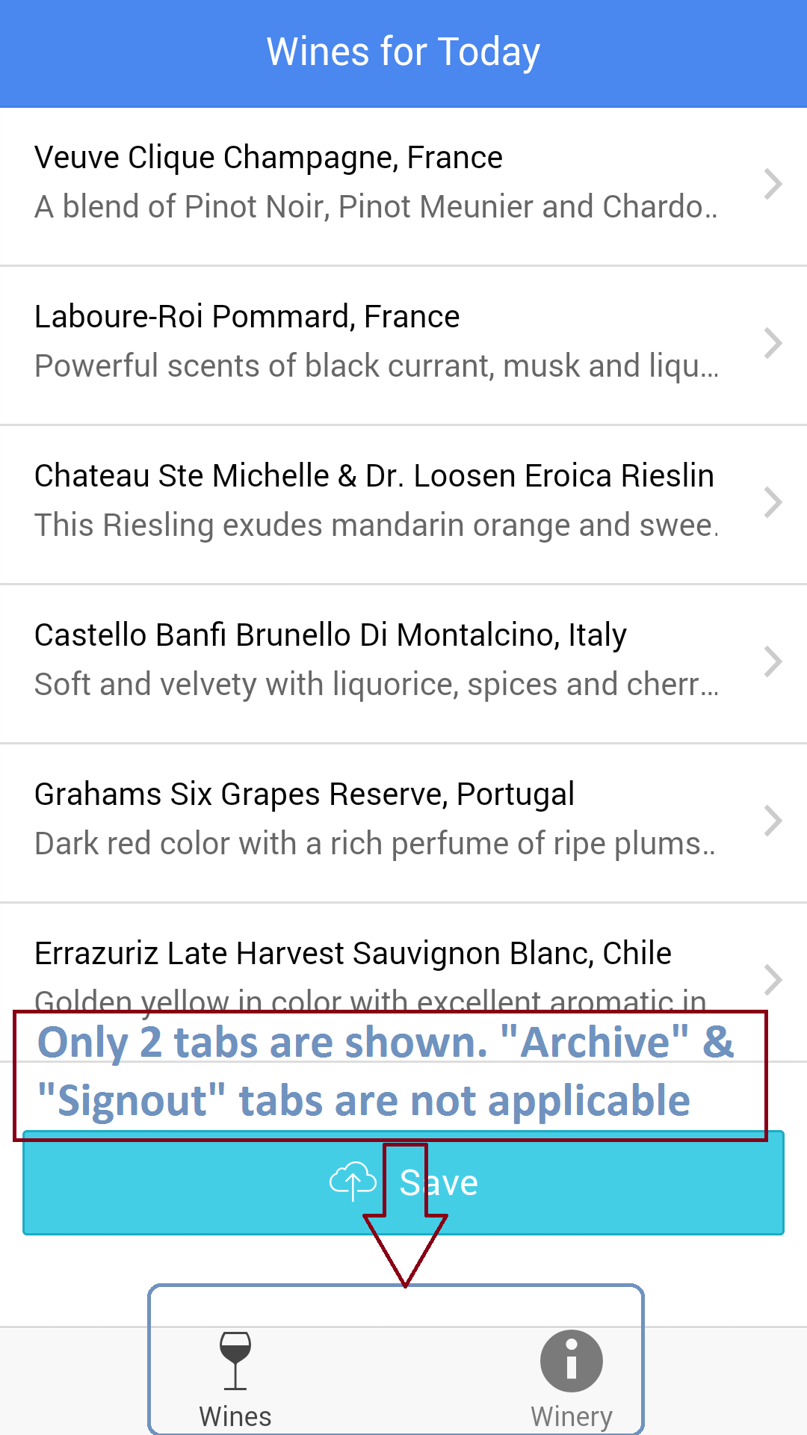
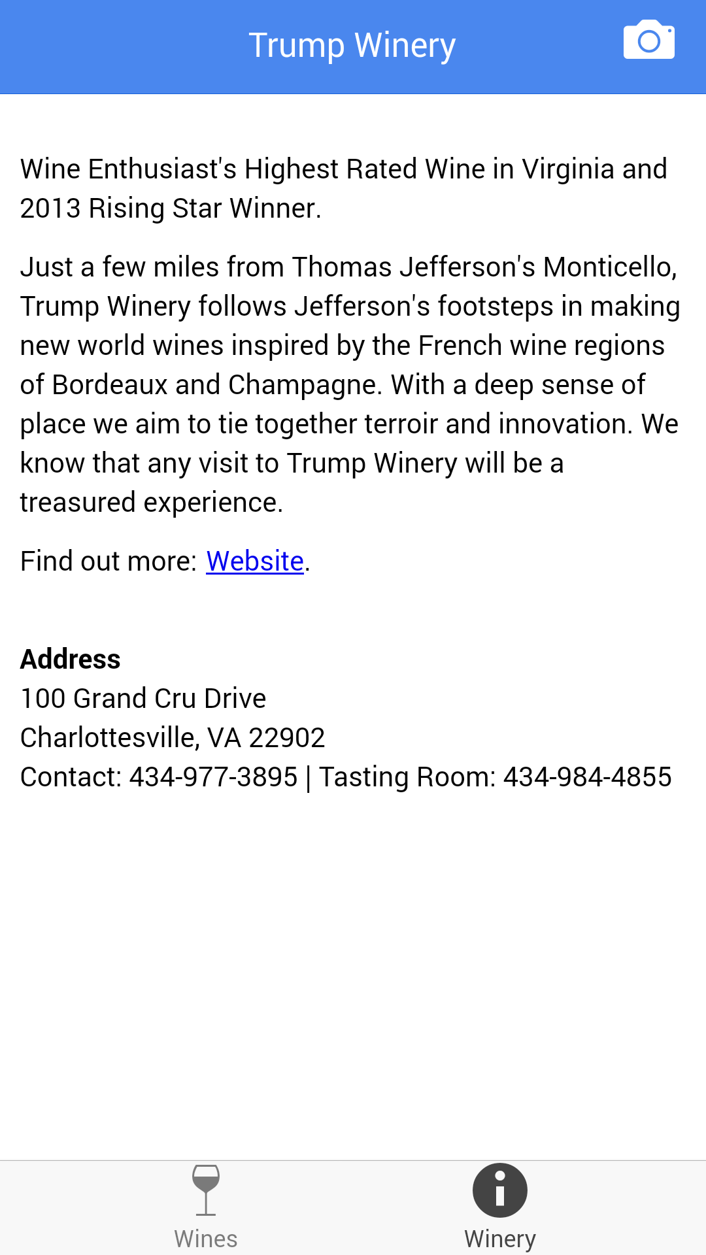
Successful scanning of the QR code returns user to a screen listing all the wines for the tasting event.
“Winery” Tab can be clicked to view winery details.

Slide 6
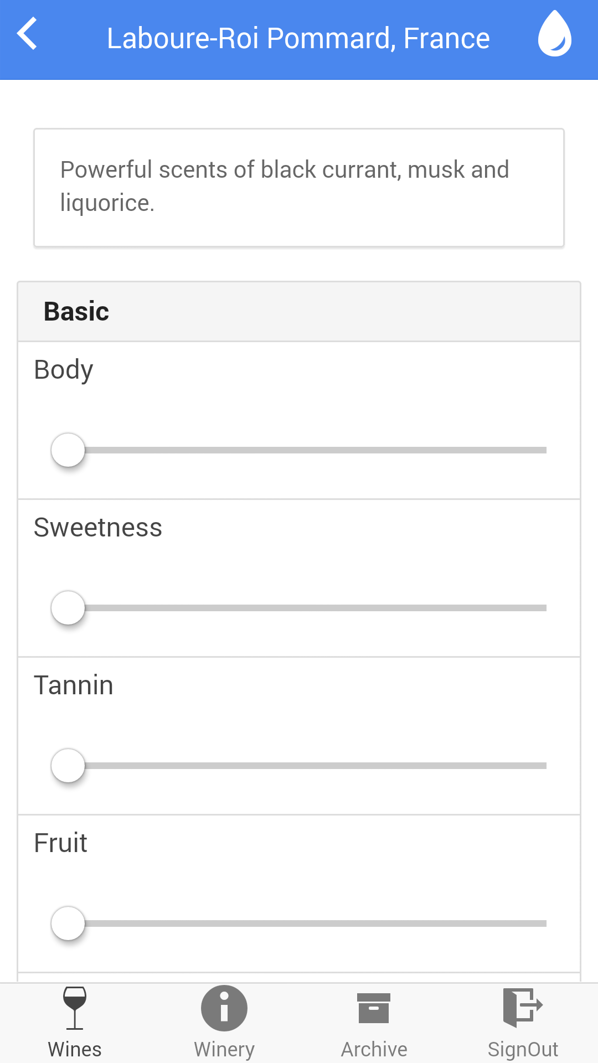
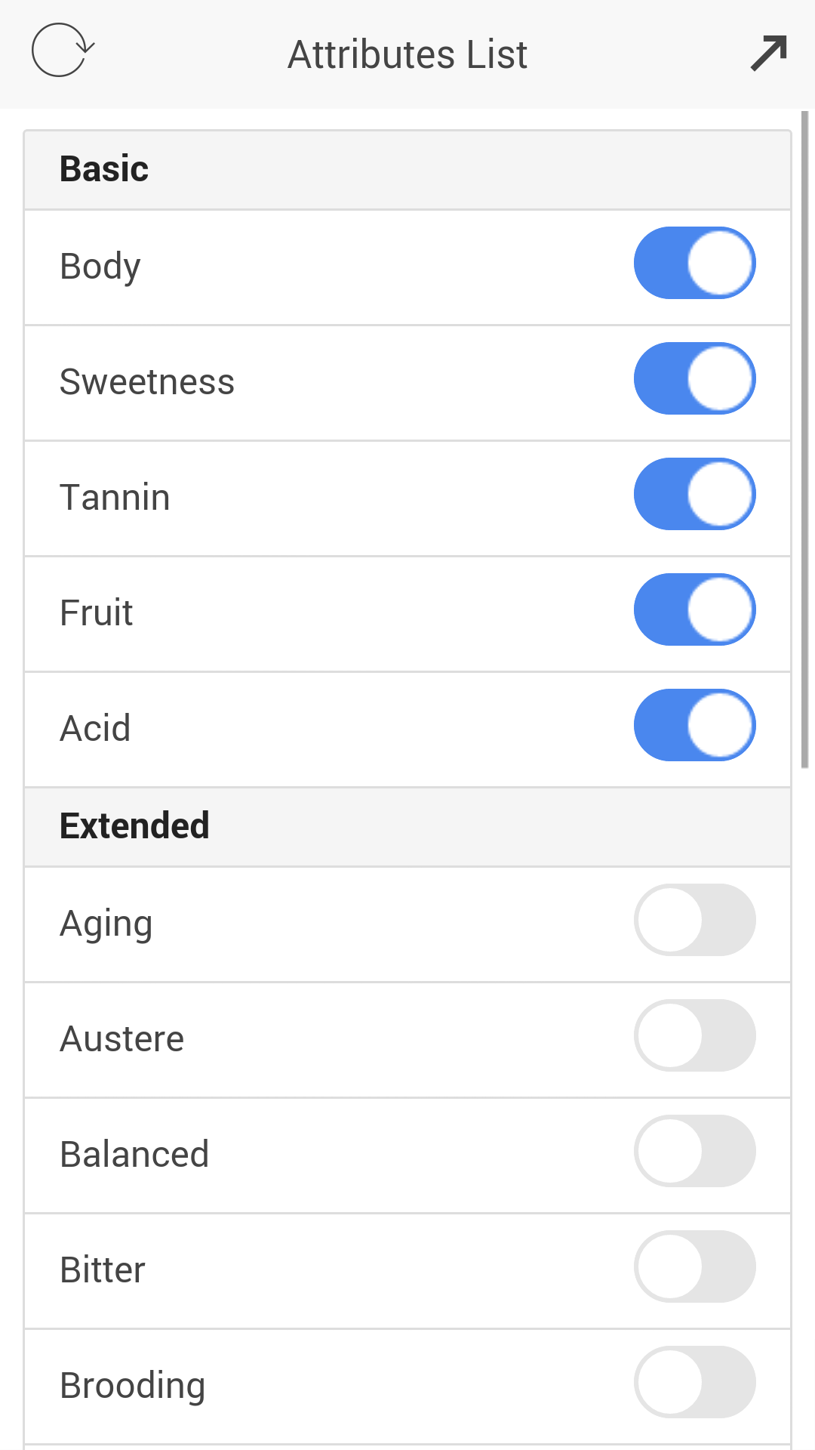
Clicking on a wine in the “Wines” Tab takes you to this next screen giving wine info and a list of attributes to rate the wine on.
The attributes list can be configured as well.

Slide 7
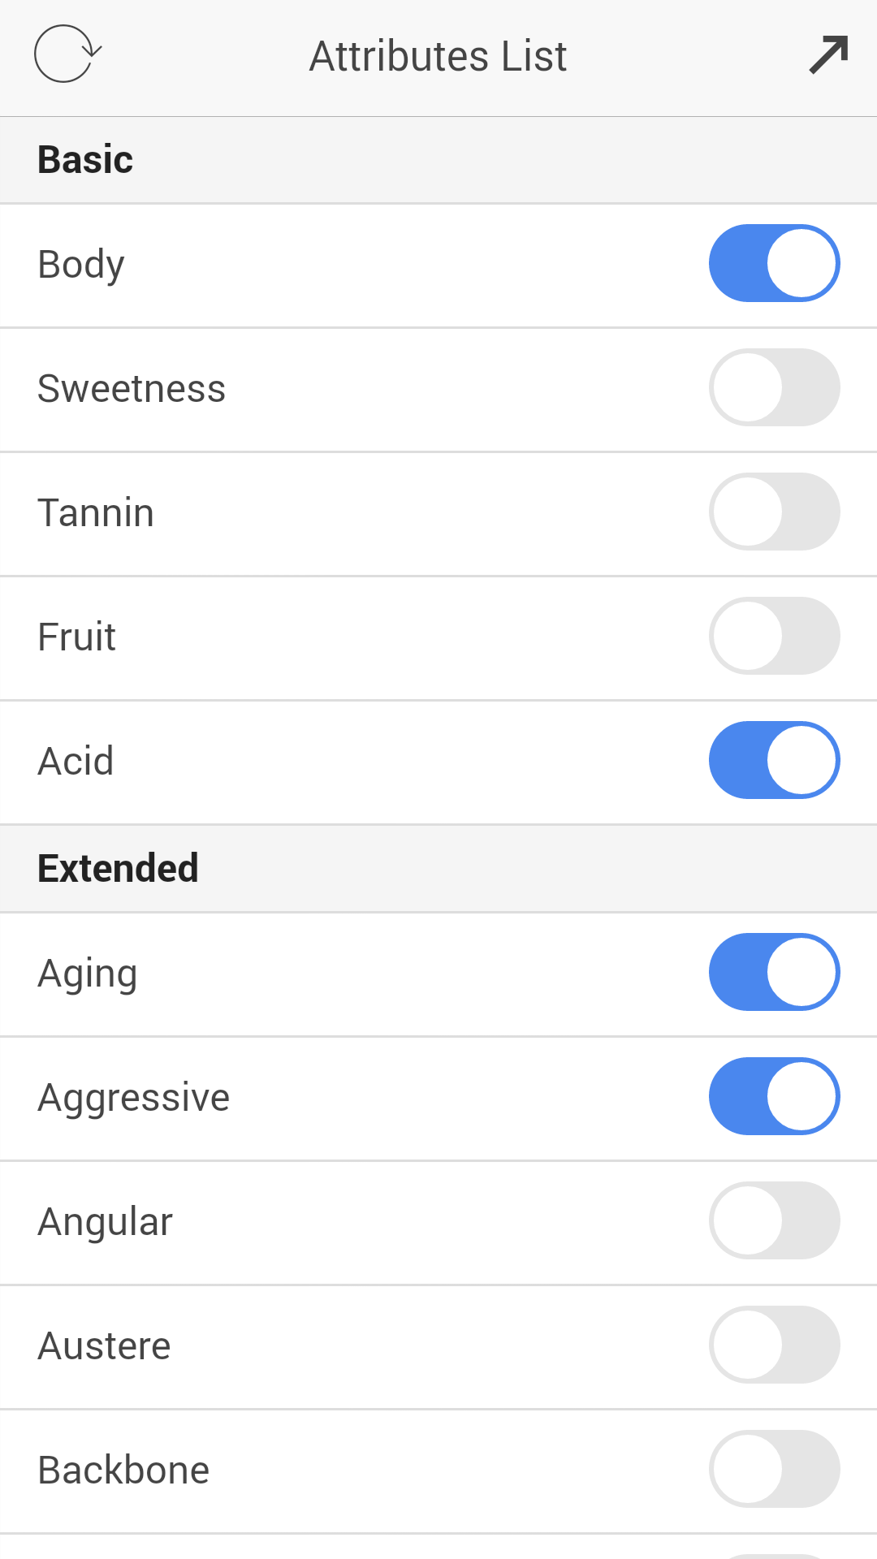
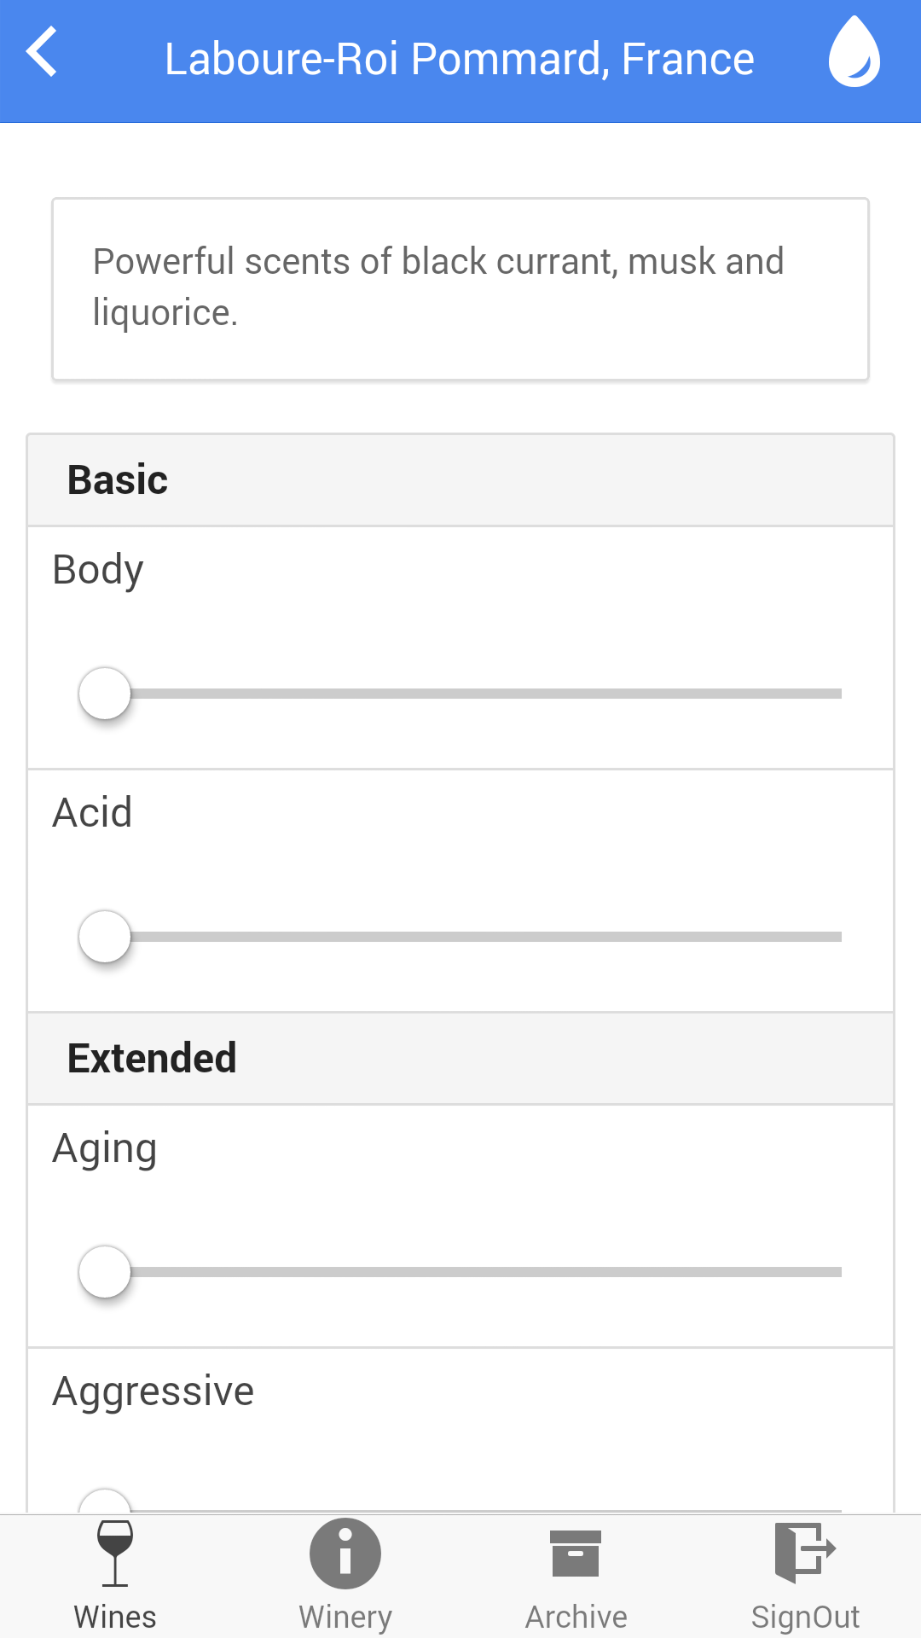
Use can select attributes by tapping the toggle buttons besides the attribute list.
Minimize the attributes list, and the new attributes for that wine show up.

Slide 8
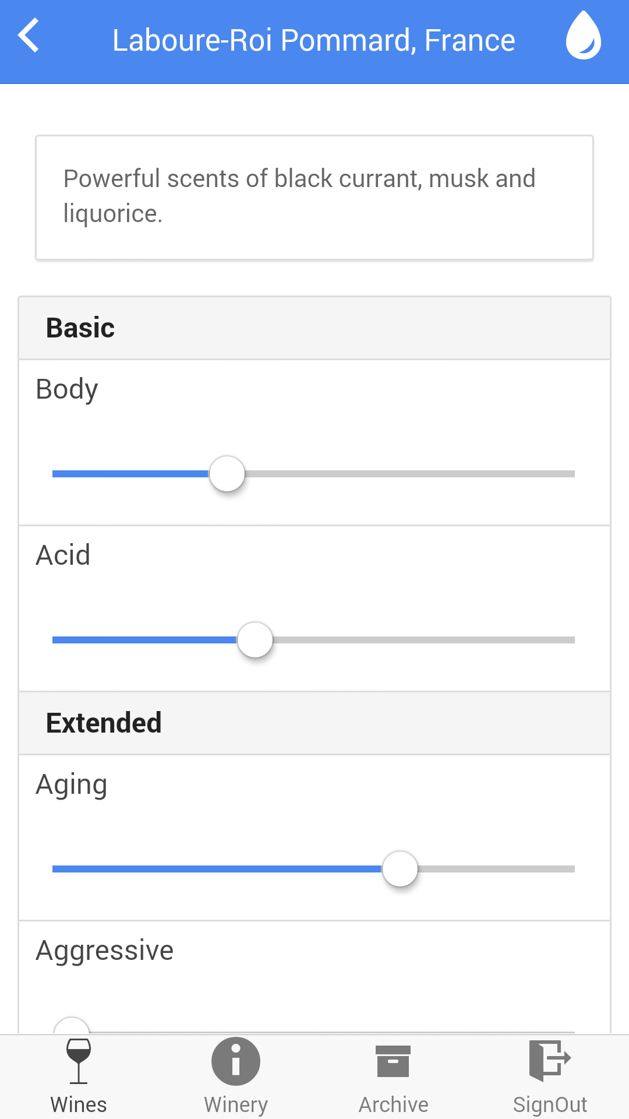
Rating is done using sliders on each of the attributes.
The user can go back and forth the attributes list and select the desired attributes from the given list.
This process is repeated for each wine

Slide 9
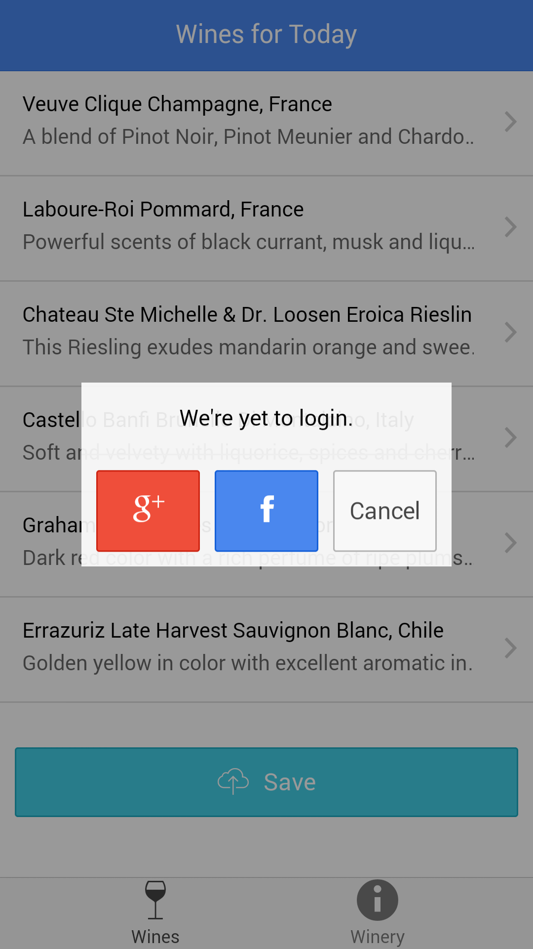
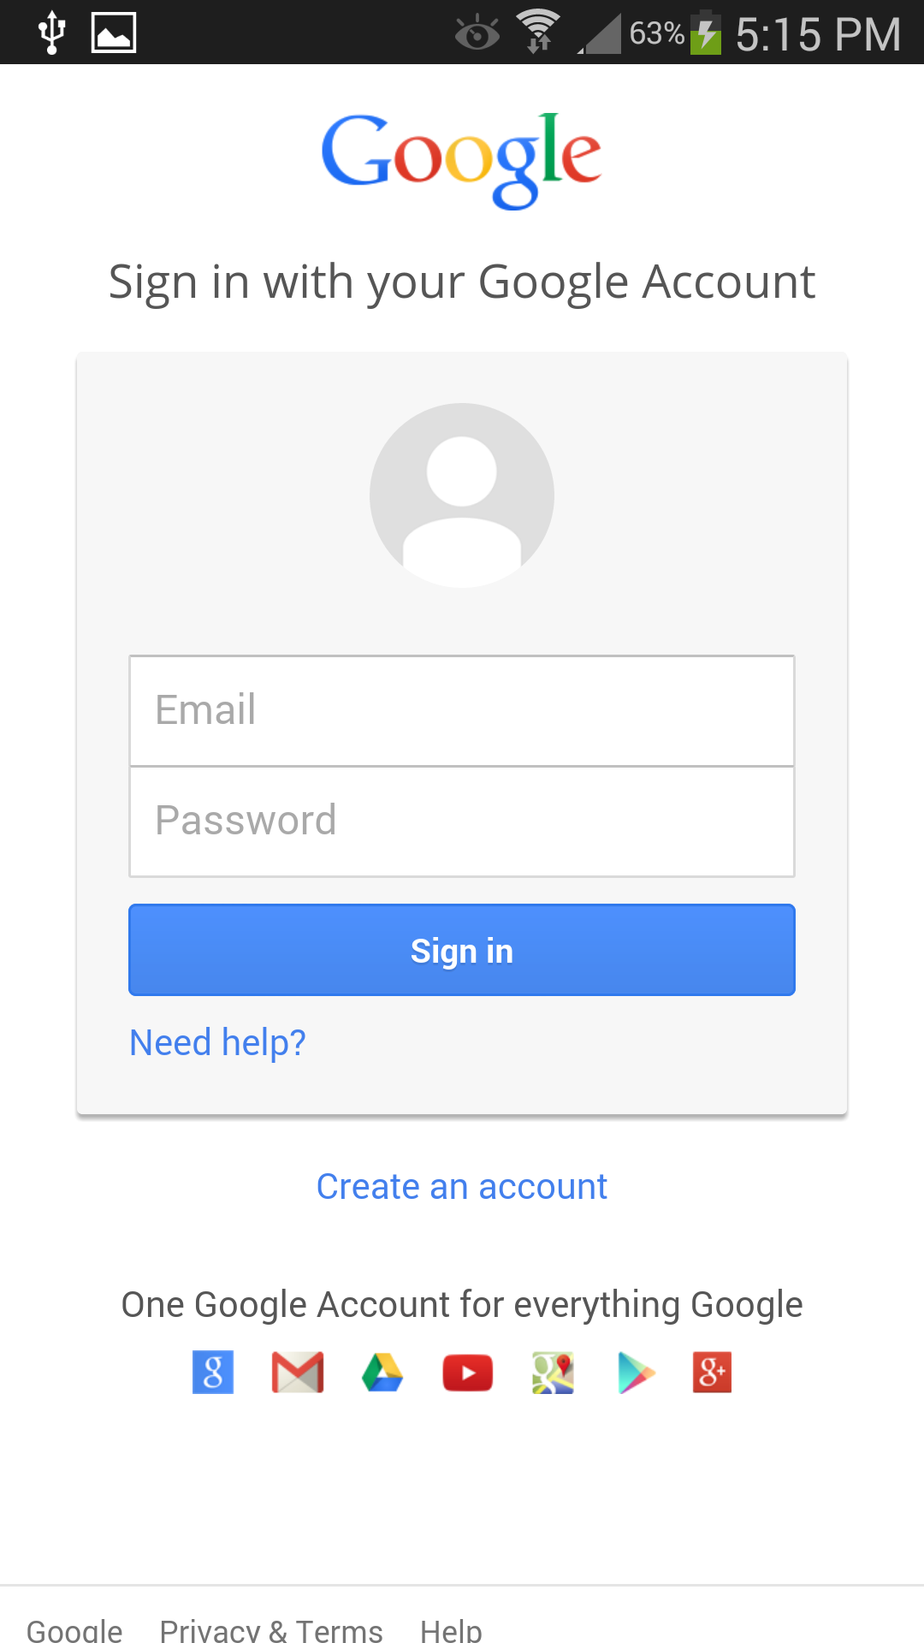
Since user began without signing in, tapping the “Save” button prompts the user to select a social provider to sign in with.
Here we have shown an example for Google.

Slide 10
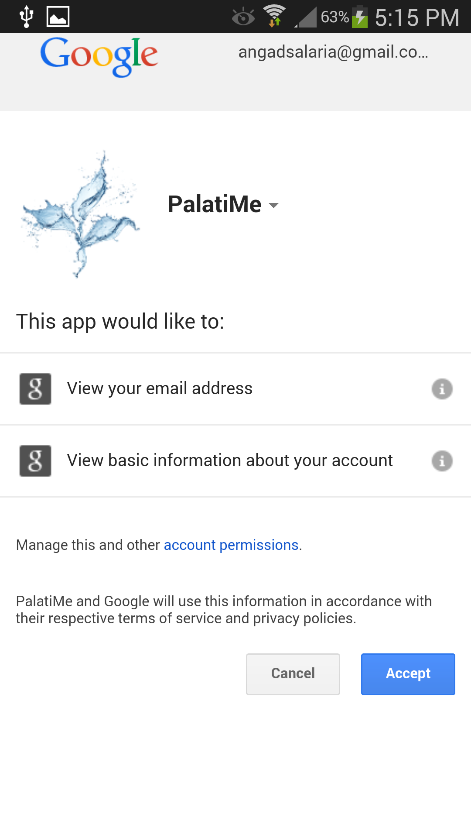
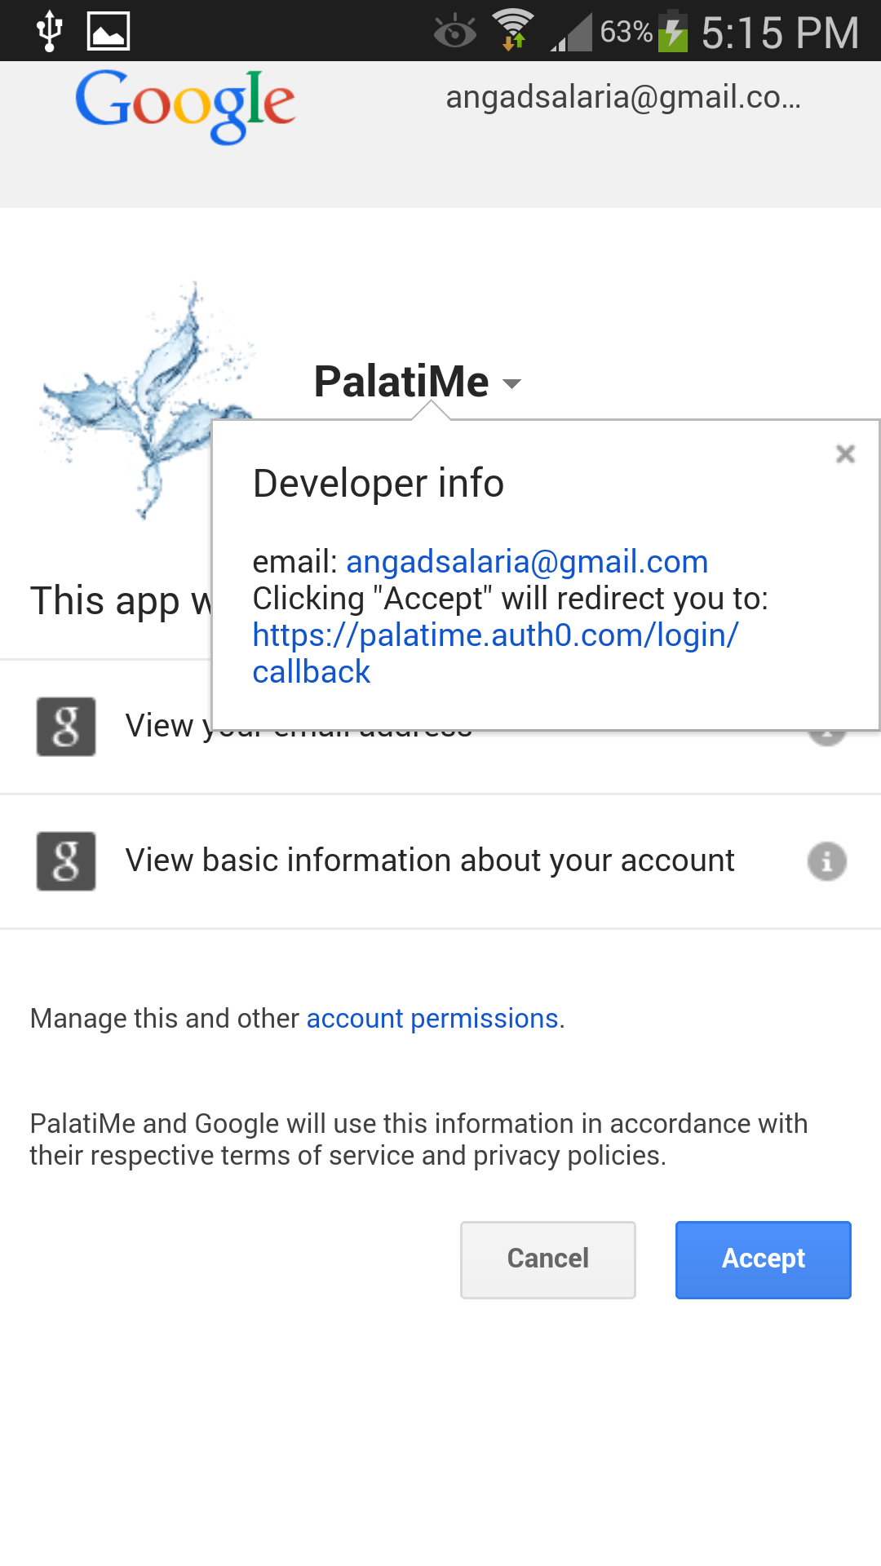
Google Permissions

Slide 11
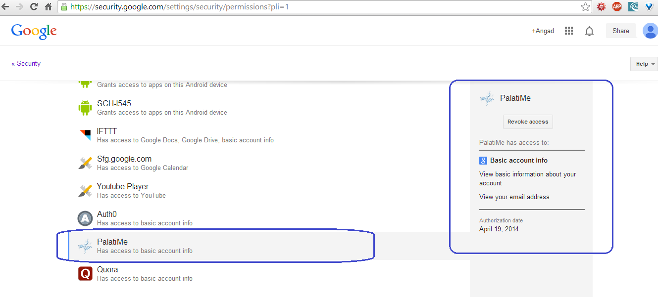
The app would show on User’s permission list in his/her account.

Slide 12
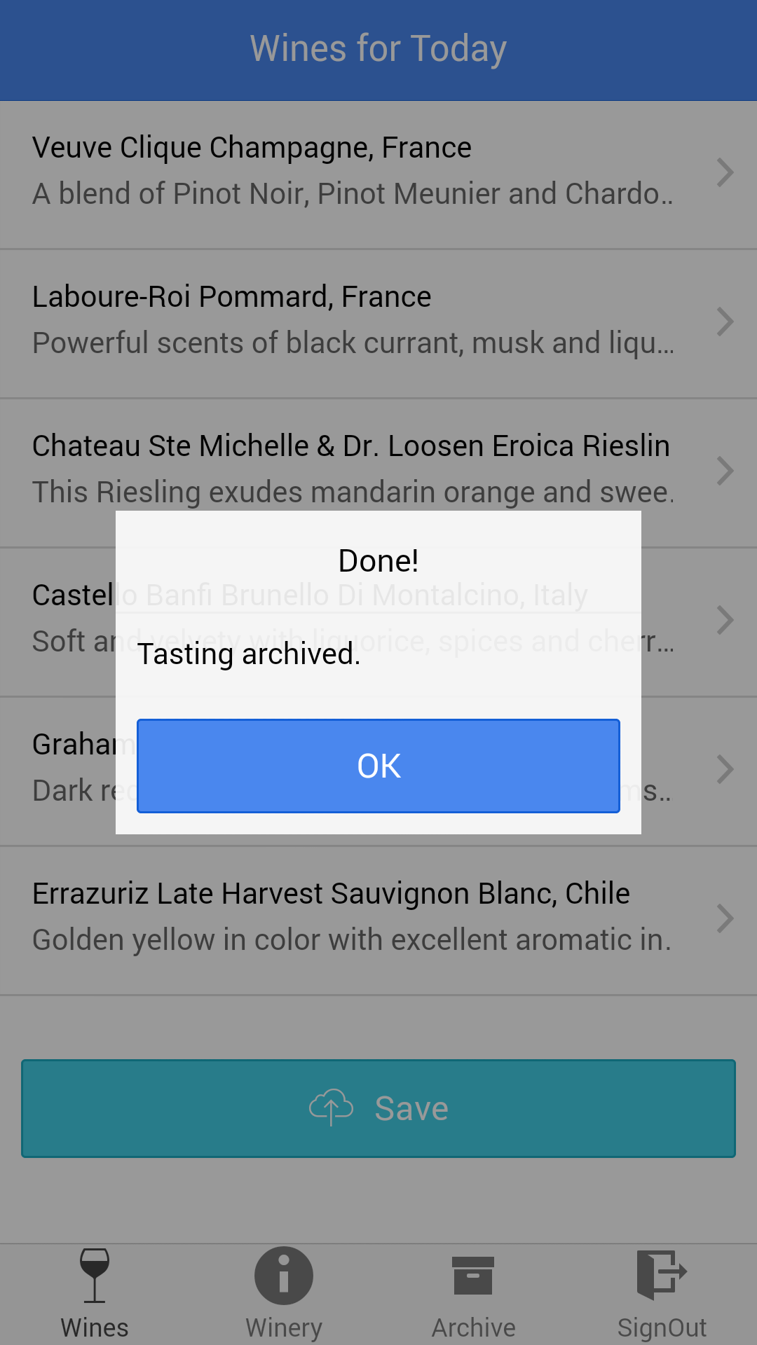
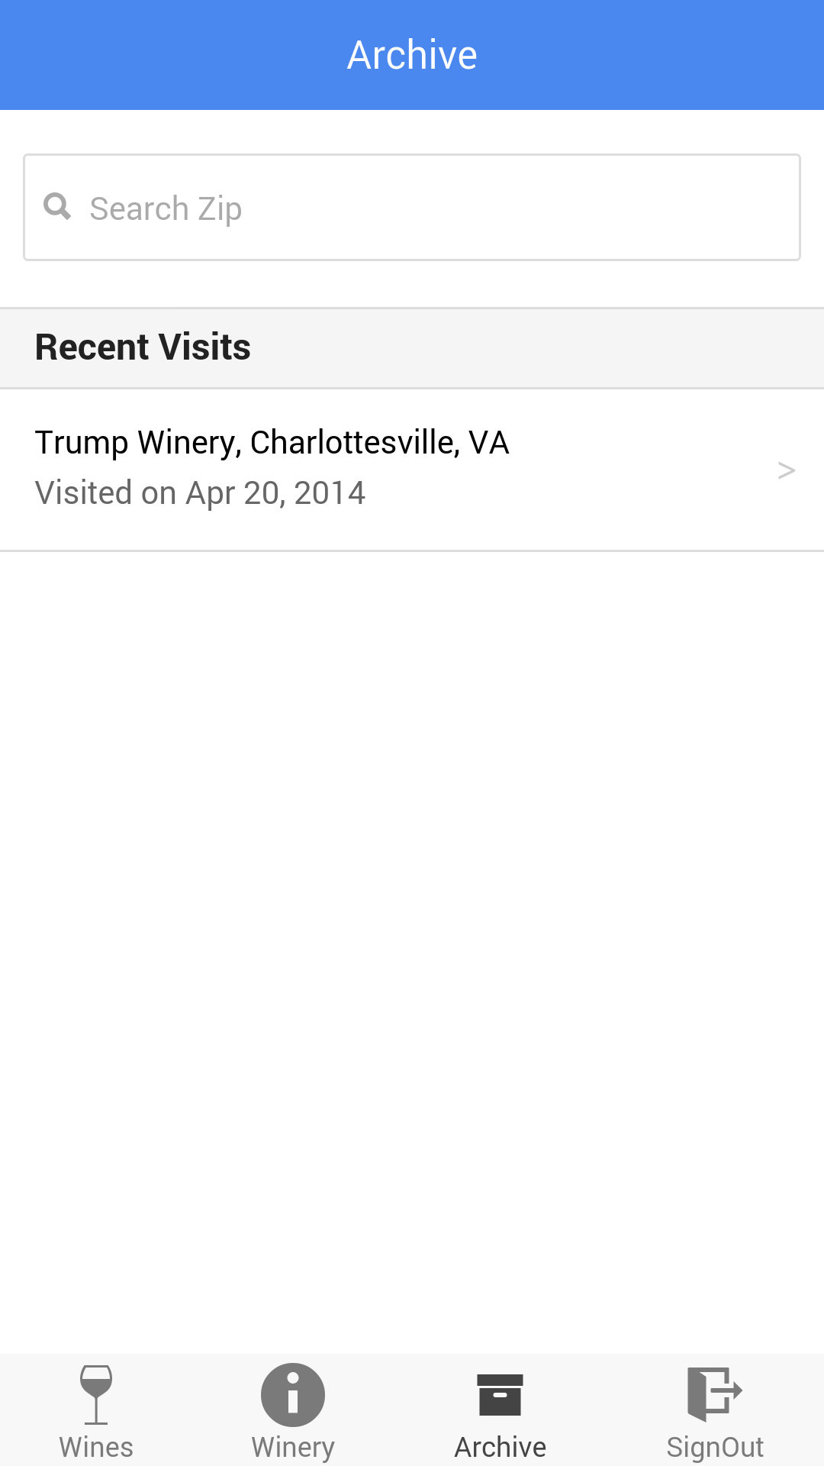
Successful login redirects back to fulfill the save request.
Click OK, and user is directed to “Archive” tab. The tasting shows up as archived.

Slide 13
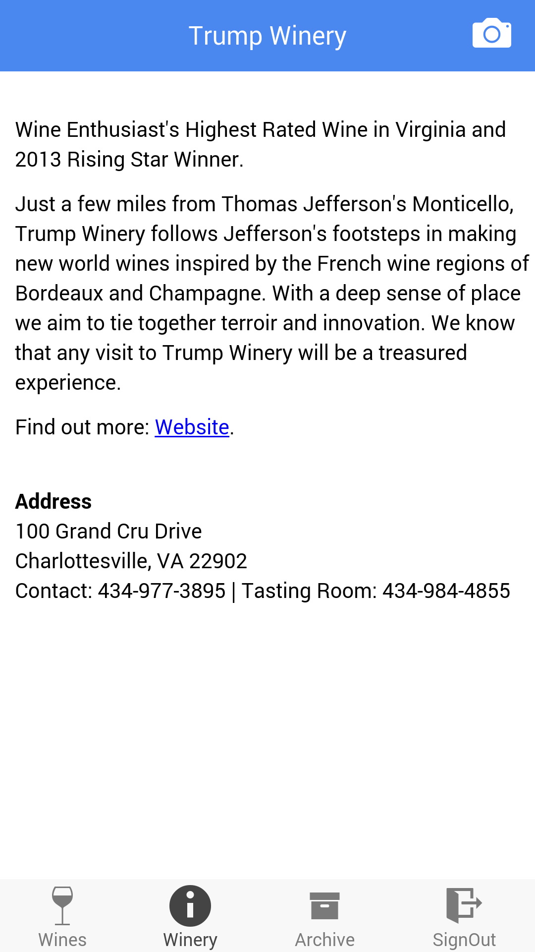
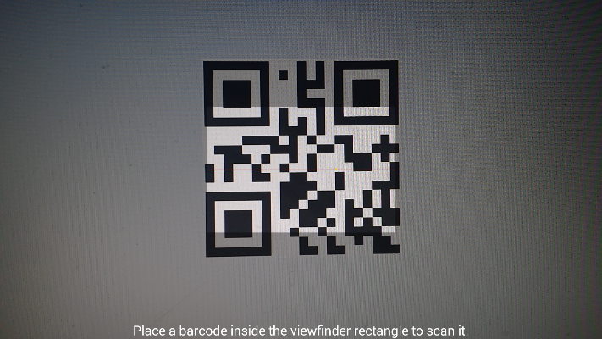
Winery can be changed anytime from the “Winery” Tab.

Slide 14
Closing the app and reopening would not require logging in again.

Slide 15
If user had signed out, then the user is given the Login page.
Signing out also leaves the user at the login page.

Slide 16
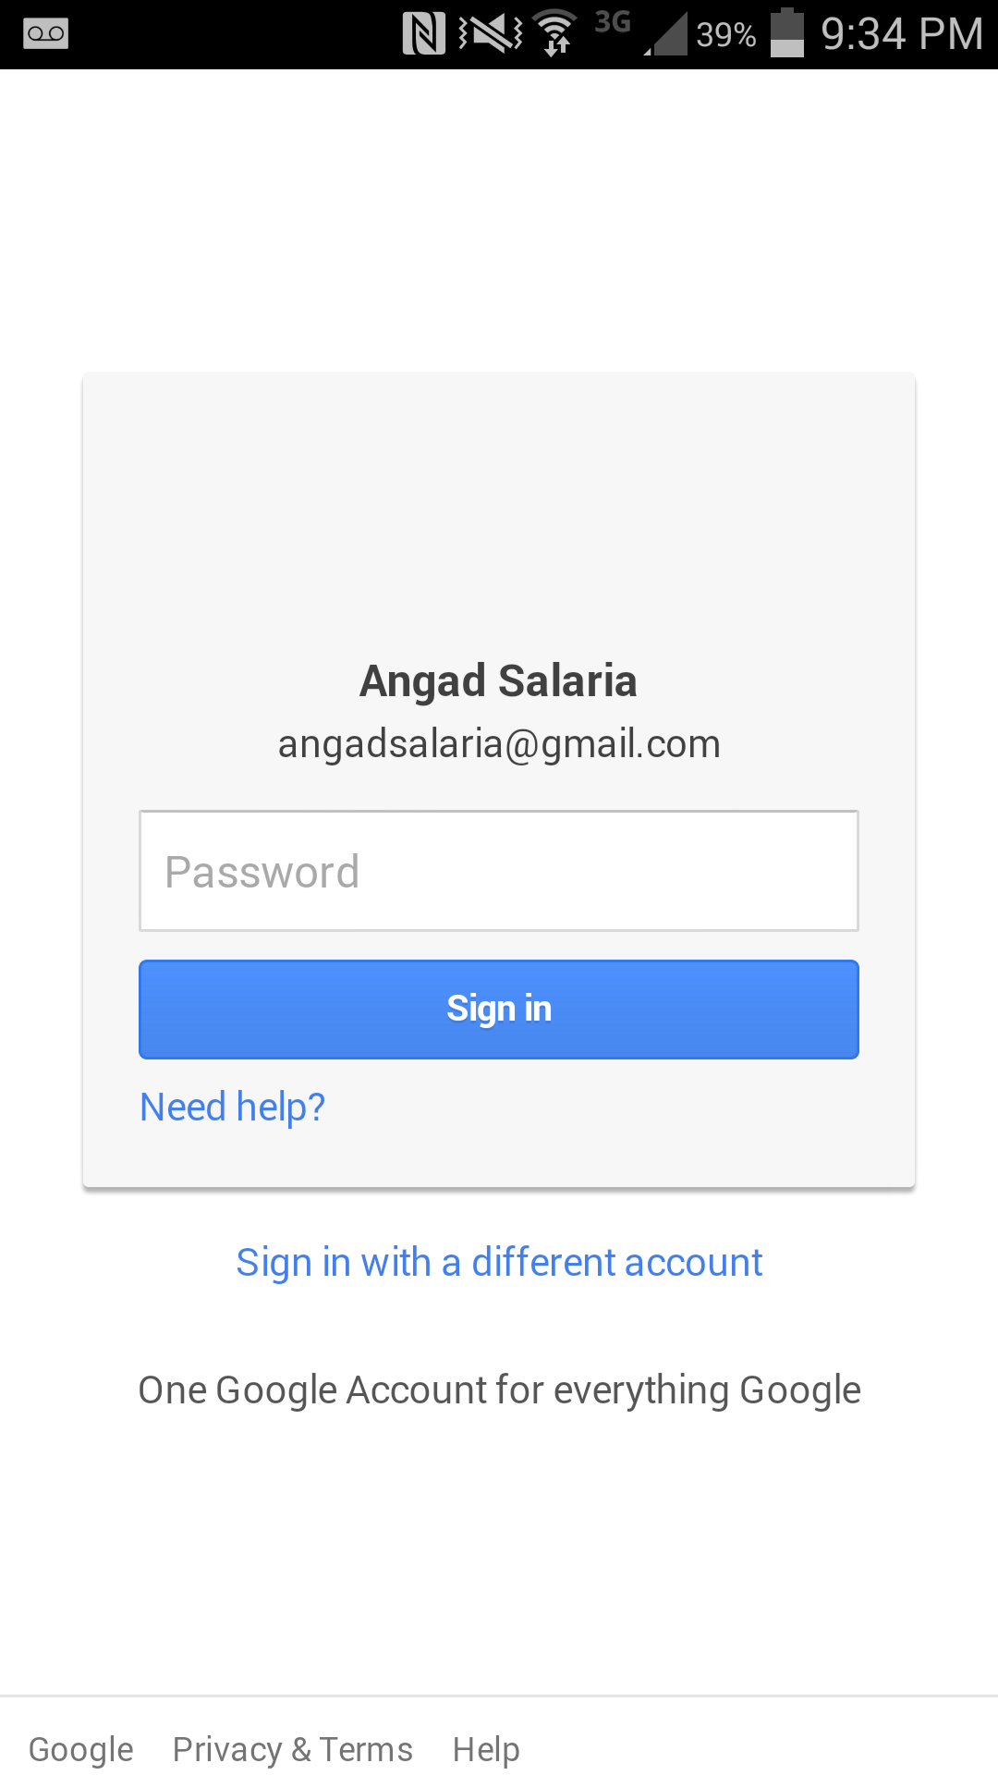
App remembers last successful signed in Id.
Successful Login redirects user to “Archive Page”

Slide 17
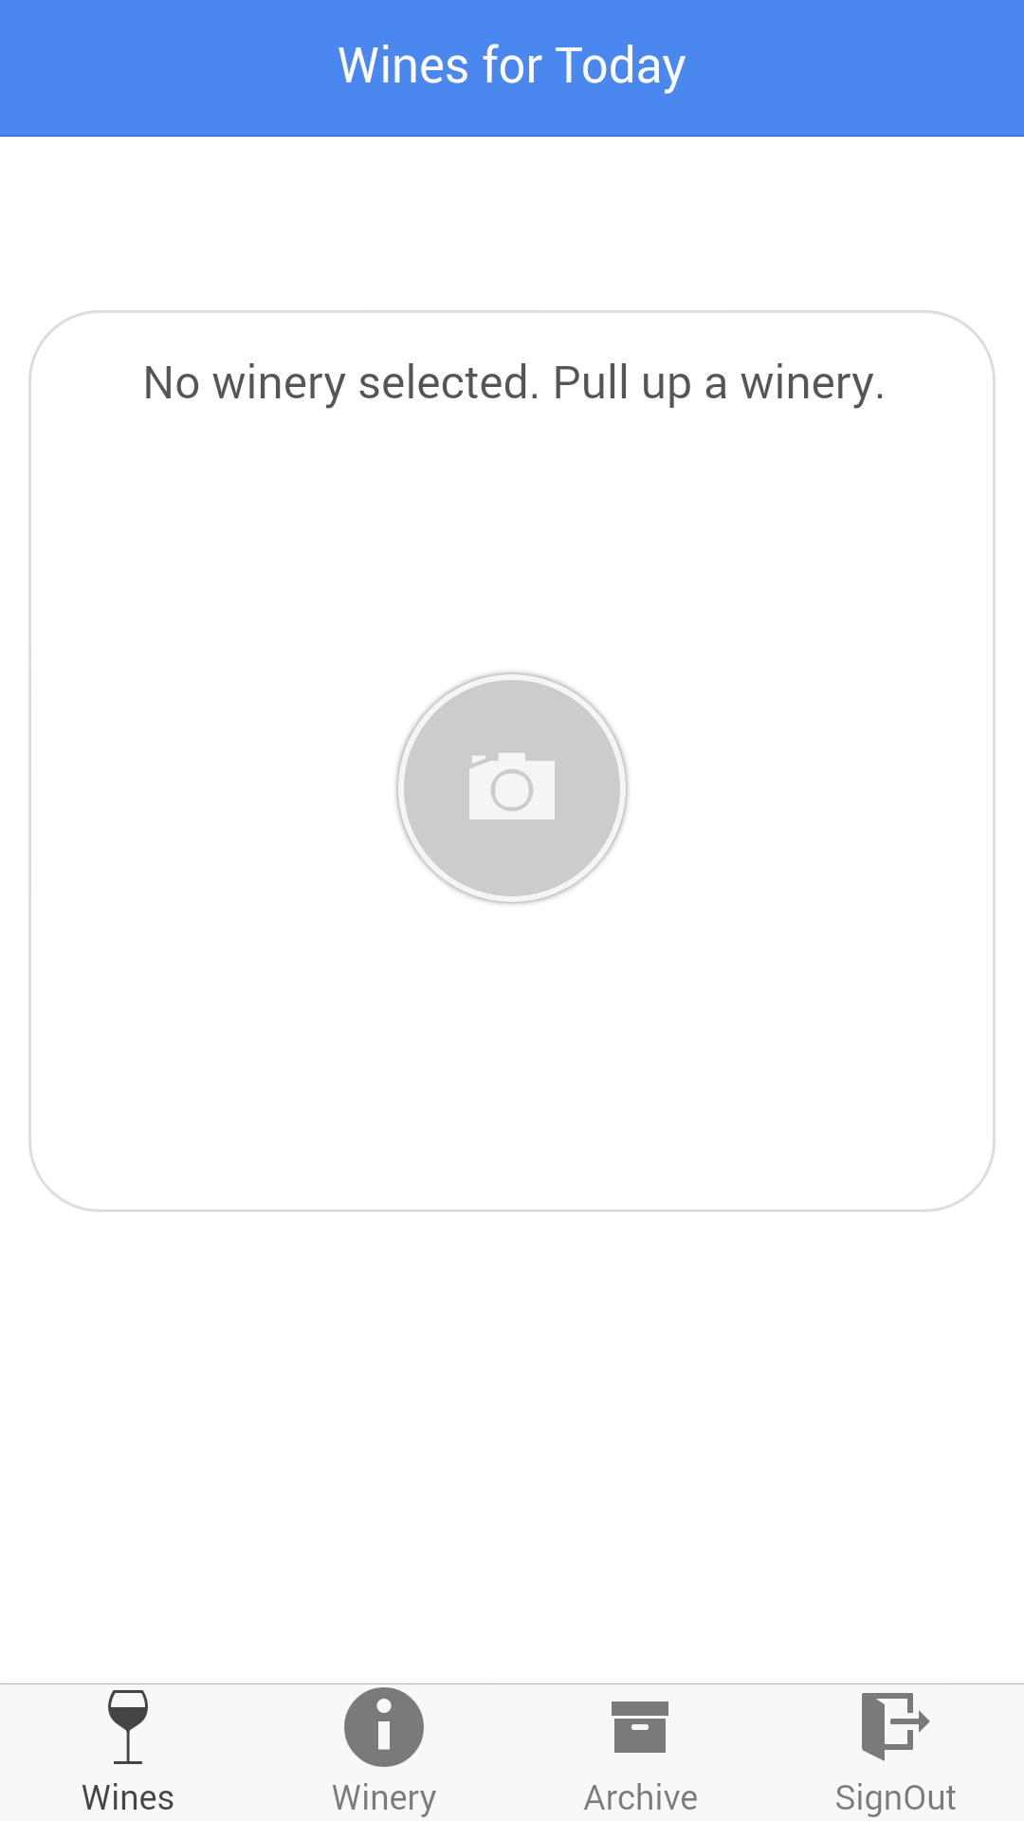
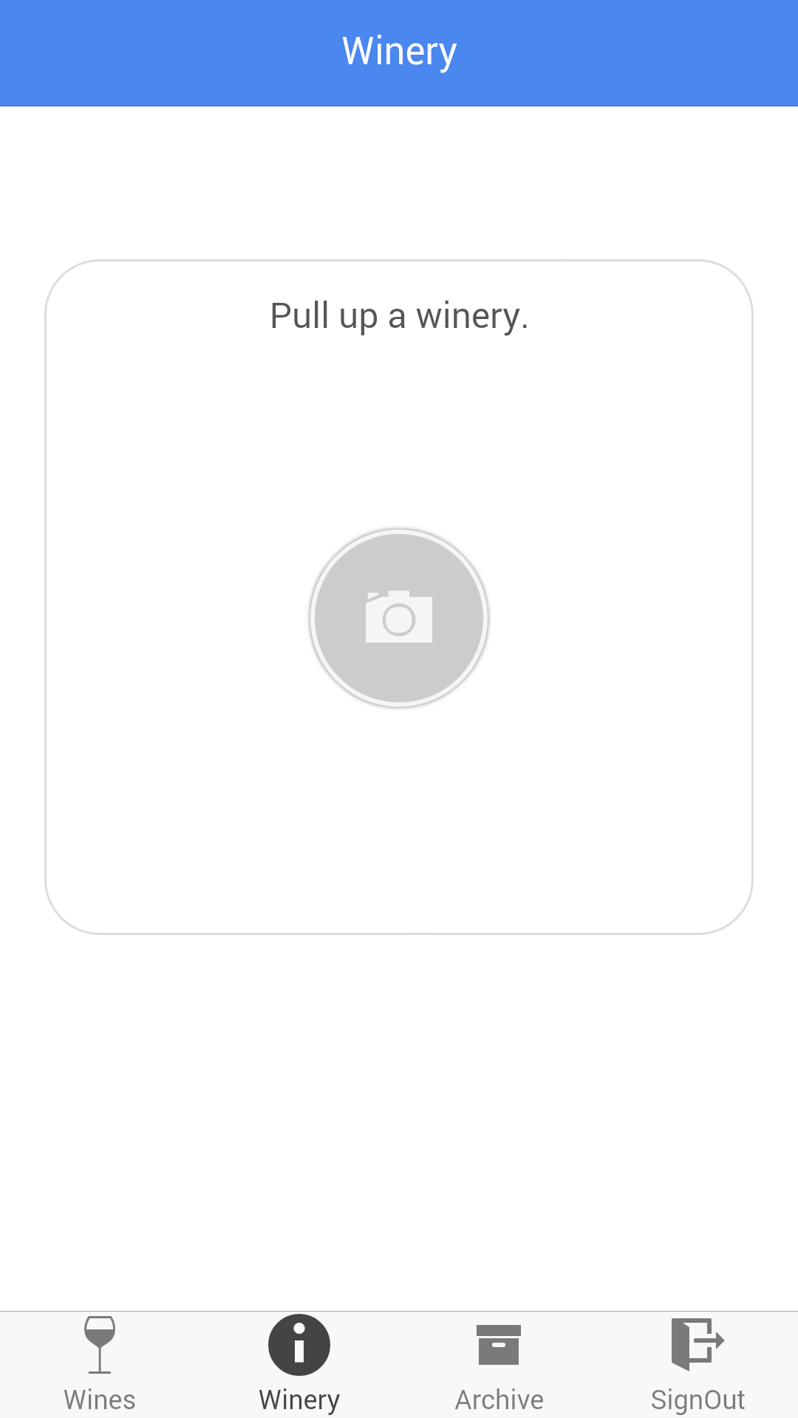

Slide 18
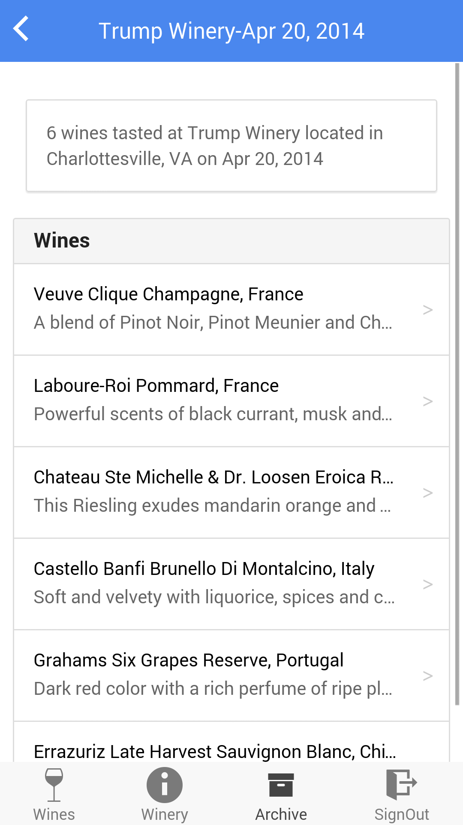
User can go through archived tastings.
Search by ZIP feature is available.

Slide 19
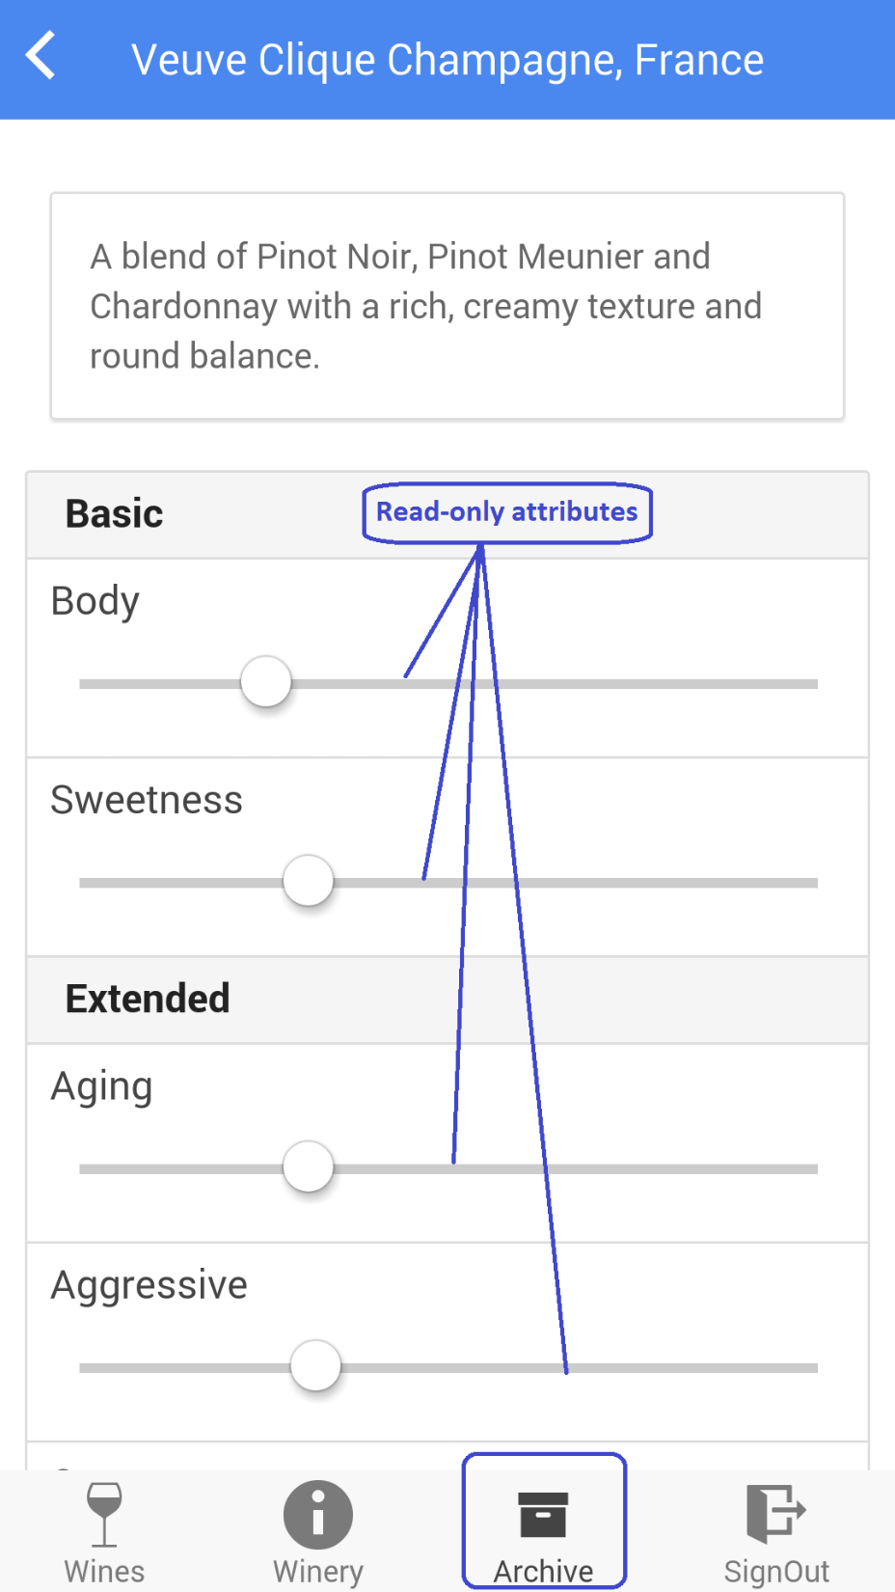
User’s tasting is shown for the wine with the captured attributes.

